Slide 1
Chapter-8
SOFTWARE TESTING

Slide 2
Software Testing
Testing is intended to show that a program does what it is intended to do and to discover program defects before it is put into use.
When you test software, you execute a program using artificial data.
You check the results of the test run for errors, anomalies or information about the program’s non-functional attributes.

Slide 3
Testing process goals
Validation testing
To demonstrate to the developer and the system customer that the software meets its requirements
A successful test shows that the system operates as intended.
Defect testing
To discover faults or defects in the software where its behavior is
incorrect or not in conformance with its specification
A successful test is a test that makes the system perform incorrectly and so exposes a defect in the system.

Slide 4
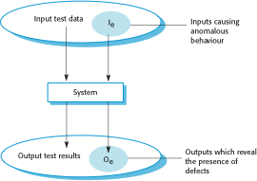
An input-output model of program testing

Slide 5
Inspections and testing
Software inspections Concerned with analysis of the static system representation to discover problems (static verification)
Software testing Concerned with exercising and observing product behaviour (dynamic verification)

Slide 6
Software inspections
These involve people examining the source representation
with the aim of discovering anomalies and defects.
Inspections not require execution of a system so may be used before implementation.
They may be applied to any representation of the system
(requirements, design, configuration data, test data, etc.).
They have been shown to be an effective technique for discovering program errors.

Slide 7
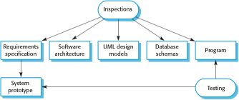
Software inspections

Slide 8
Stages of testing
Development testing, where the system is tested during
development to discover bugs and defects.
Release testing, where a separate testing team test a complete version of the system before it is released to users.
User testing, where users or potential users of a system test the system in their own environment.

Slide 9
Development Testing
Development testing includes all testing activities that are
carried out by the team developing the system.
Unit testing, where individual program units or object classes are tested. Unit testing should focus on testing the functionality of objects or methods.
Component testing, where several individual units are integrated to create composite components. Component testing should focus on testing component interfaces.
System testing, where some or all of the components in a system are integrated and the system is tested as a whole. System testing should focus on testing component interactions.

Slide 10
Unit testing
Unit testing is the process of testing individual components in
isolation.
Units may be:
Individual functions or methods within an object
Object classes with several attributes and methods
Tests should be call to these methods with different input parameters
Complete test coverage of a class involves
Testing all operations associated with an object
Setting and interrogating all object attributes
Exercising the object in all possible states.

Slide 11
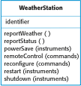
The weather station object interface

Slide 12
Weather station testing
Need to define test cases for reportWeather, test, startup and
shutdown.
Using a state model, identify sequences of state transitions to be tested and the event sequences to cause these transitions
For example:
Shutdown -> Running-> Shutdown
Configuring-> Running-> Testing -> Transmitting -> Running
Running-> Collecting-> Running-> Summarizing -> Transmitting -> Running

Slide 13
Unit test effectiveness
This leads to 2 types of unit test case:
The first of these should reflect normal operation of a program and should show that the component works as expected.
The other kind of test case should be based on testing experience of where common problems arise. It should use abnormal inputs to check that these are properly processed and do not crash the component.

Slide 14
Partition testing
Input data and output results often fall into different classes
where all members of a class are related.
Each of these classes is an equivalence partition or domain where the program behaves in an equivalent way for each class member.
Test cases should be chosen from each partition.

Slide 15
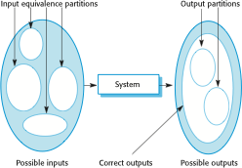
Partition testing

Slide 16
Partition testing
Equivalence Partitioning – It is a black box technique (code is not visible to tester) which can be applied to all levels of testing like unit, integration, system etc. In this technique, you divide set of test condition into partition that can be considered the same

Slide 17
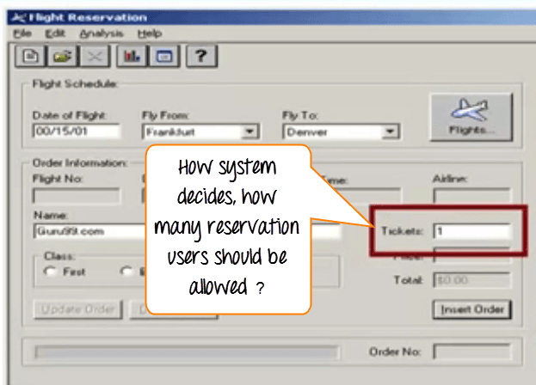
Equivalence Partitioning-Example

Slide 18
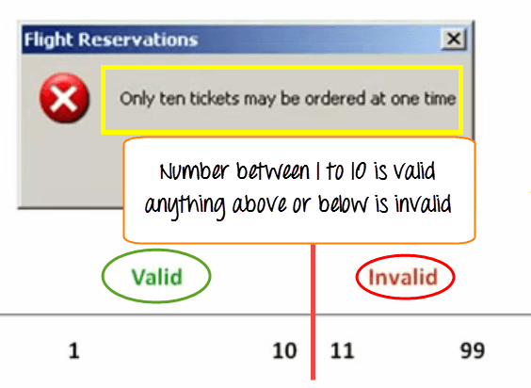
Equivalence Partitioning-Example

Slide 19
Equivalence Partitioning-Example
Here is the test condition
Any Number greater than 10 entered in the reservation column (let say 11) is considered invalid.
Any Number less than 1 that is 0 or below, then it is considered invalid.
Numbers 1 to 10 are considered valid
Any 3 Digit Number say -100 is invalid

Slide 20
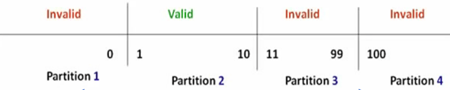
Equivalence Partitioning-Example
The divided sets are called Equivalence Partitions or Equivalence Classes. Then we pick only one value from each partition for testing. The hypothesis behind this technique is that if one condition/value in a partition passes all others will also pass. Likewise, if one condition in a partition fails, all other conditions in that partition will fail.

Slide 21
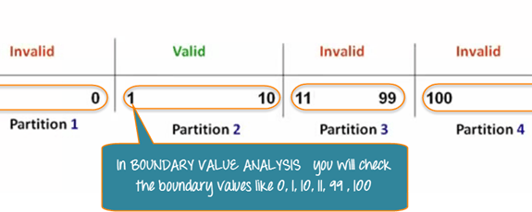
Boundary Value Analysis
Boundary Value Analysis- in Boundary Value Analysis, you
test boundaries between equivalence partitions

Slide 22
Black-box and white-box testing
When you use the specification of a system to identify test cases,
this is called ‘black-box testing’.
Here, you don’t need any knowledge of how the system works.
In ‘white-box testing’, you look at the code of the program to find possible test cases.

Slide 23
Testing guidelines (sequences)
Test software with sequences which have only a single value.
Use sequences of different sizes in different tests.
Derive tests so that the first, middle and last elements of the sequence are accessed.
Test with sequences of zero length.

Slide 24
General testing guidelines
Choose inputs that force the system to generate all error
messages
Design inputs that cause input buffers to overflow
Repeat the same input or series of inputs numerous times
Force invalid outputs to be generated
Force computation results to be too large or too small.

Slide 25
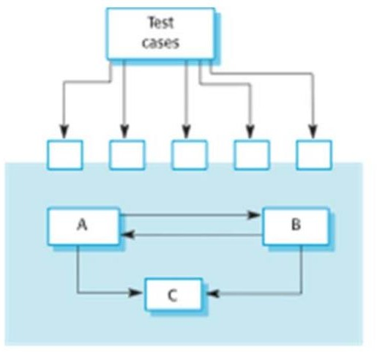
Interface testing

Slide 26
Interface testing
Objectives are to detect faults due to interface errors or invalid assumptions about
interfaces.
Interface types
Parameter interfaces Data passed from one method or procedure to another.
Shared memory interfaces Block of memory is shared between procedures
or functions.
Procedural interfaces Sub-system encapsulates a set of procedures to be called by other sub-systems
Message passing interfaces These are interfaces in which one component requests a service from another component by passing a message to it.

Slide 27
System testing…
System testing during development involves integrating components to create a version of the system and then testing the integrated system.
The focus in system testing is testing the interactions between
components.
System testing checks that components are compatible, interact correctly and transfer the right data at the right time across their interfaces.

Slide 28
…System testing
During system testing, reusable components that have been separately developed and off-the-shelf systems may be integrated with newly developed components. The complete system is then tested.
Components developed by different team members or sub- teams may be integrated at this stage. System testing is a collective rather than an individual process.
— In some companies, system testing may involve a separate testing team
with no involvement from designers and programmers.

Slide 29

Test-driven development

Slide 30
Benefits of test-driven development
Code coverage
Every code segment that you write has at least one associated test so all code written has at least one test.
Regression testing
A regression test suite is developed incrementally as a program is
developed.
Simplified debugging
When a test fails, it should be obvious where the problem lies. The newly written code needs to be checked and modified.
System documentation
The tests themselves are a form of documentation that describe what the code should be doing.

Slide 31
Release testing…
Release testing is the process of testing a particular release of a system that is intended for use outside of the development team.
The primary goal of the release testing process is to convince the supplier of the system that it is good enough for use.
— Release testing, therefore, has to show that the system delivers its specified functionality, performance and dependability, and that it does not fail during normal use.
Release testing is usually a black-box testing process where tests are only derived from the system specification.

Slide 32
…Release testing
Release testing is a form of system testing.
Important differences:
A separate team that has not been involved in the system development, should be responsible for release testing.
System testing by the development team should focus on discovering bugs in the system (defect testing). The objective of release testing is to check that the system meets its requirements and is good enough for external use (validation testing).

Slide 33
Performance testing
Part of release testing may involve testing the emergent
properties of a system, such as performance and reliability.
Tests should reflect the profile of use of the system.
Performance tests usually involve planning a series of tests where the load is steadily increased until the system performance becomes unacceptable.
Stress testing is a form of performance testing where the system is deliberately overloaded to test its failure behavior.

Slide 34
User testing
User or customer testing is a stage in the testing process in which users or customers provide input and advice on system testing.
User testing is essential, even when comprehensive system and release testing have been carried out.
— The reason for this is that influences from the user’s working environment have a major effect on the reliability, performance, usability and robustness of a system. These cannot be replicated in a testing environment.

Slide 35
Types of user testing
There are three different types of user testing:
1. Alpha testing, where a selected group of software users work closely with the development team to test early releases of the software.
2. Beta testing, where a release of the software is made available to a larger group of users to allow them to experiment and to raise problems that they discover with the system developers.
3. Acceptance testing, where customers test a system to decide whether or not it is ready to be accepted from the system developers and deployed in the customer environment.

Slide 36

The acceptance testing process

Slide 37
Stages in the acceptance testing process
Define acceptance criteria
Plan acceptance testing
Derive acceptance tests
Run acceptance tests
Negotiate test results
Reject/accept system

